Slide 1
Early Years Apprenticeships Information webinar

Slide 2
Welcome!
This session is designed to inform you about the early years apprenticeships from level 2-5.
What do you hope to get out of this session?

Slide 3
What is an apprenticeship?
An apprenticeship is a learning programme that allows learners to learn while they earn.
Notes:
Apprentices are members of staff
Apprentices must have a contract of employment that covers the duration of their programme
Apprentices cannot contribute to the cost of their training
Apprentices must be allowed time to study
Apprentices must be on programme for a minimum of 12 months
Employers (Mentors) must attend and contribute to the Apprentice Induction and agree the individual learning plan
This is a collaboration whereby BPN supports the Employer and the apprentice

Slide 4
What is an apprenticeship made up of?
Standard (Knowledge, skills and behaviours)
Maths and English functional skills
Off the job training
Gateway
End point assessment
Notes:
Apprenticeship elements:
Standard – knowledge, skills and behaviours to be met
Maths and English FS
Off the job training
Gateway – confirm ready for EPA
EPA

Slide 5
What are the benefits of our early years apprenticeships?
Support development of practitioners to help them to excel in their role
Allows apprentices to apply theoretical learning into practice in the workplace
Provides a fully recognised qualification in line with the EYFS requirements
Offers a route into higher education whilst working and gaining practical experience
Develops confidence, communication skills and supports wider learning
Opportunity to gain a fully funded qualification (95% government funded)

Slide 6
Early years apprenticeships – progression route
Early Years Practitioner level 2 apprenticeship
Early Years Educator level 3 apprenticeship
Early Years Lead Practitioner level 5 apprenticeship
Top up degree in early years
Early Years Initial Teacher Training (EYITT)
Notes:
We are partnered with a university who we can recommend for an online top up degree however we advise enquiring directly with universities on their entry requirements.

Slide 7
Our Delivery Plan
Blended programme of face to face and online study
Specialist 1-2-1 Tutor Support
BPN boost – personal development, career information advice and guidance and welfare programme
Regular reflections on learning and practice
Partnership working between BPN, the apprentice and the employer
Progress reviews every 6 weeks

Slide 8
EYP L2
13 month programme + 3 months EPA (for full time learner)
Functional skills maths and English L1 required if apprentice does not already have equivalent qualifications (mandatory for 16-18 year olds)
L2 NQUAL diploma – Early Years Practitioner
Ideal for learners who are new to an early years setting/the workplace or not quite ready for level 3
Consists of 9 core modules, including child development, health and safety, safeguarding and purposeful play & assessment
EPA methods: multiple choice test and a professional discussion underpinned by a portfolio of evidence
https://www.instituteforapprenticeships.org/apprenticeship-standards/early-years-practitioner-v1-0
Notes:
EYP L2 Apprenticeship
Curriculum plan
Bud build
Webinar booking
Learner journey

Slide 9
Early Years Educator L3
15 month programme + 3 months EPA (for full time learner – minimum duration 12 months)
Fully recognised and supports meeting ratio requirements for EYE L3 in an EY setting
Functional skills maths and English L2 (mandatory for 16-18 year olds)
Learners will need to complete paediatric first aid and submit their certificate as part of their apprenticeship
Consists of 11 modules + end point assessment preparation – including safeguarding, H&S, child development, a unique child, enabling environments and teaching, learning & assessment
End point assessment methods – observation and questioning, professional discussion and portfolio of evidence
https://www.instituteforapprenticeships.org/apprenticeship-standards/early-years-educator-in-revision
Notes:
EYE L3 Apprenticeship
Curriculum plan
Bud build
Webinar booking
Learner journey

Slide 10
Early Years Lead Practitioner Level 5
18 month programme + 6 months EPA (for full time learner – minimum duration 12 months)
Designed for those in a leadership role in an EY setting
Functional skills maths and English L2 (mandatory for 16-18 year olds)
Delivered in cohorts
19 online sessions including leadership practice, the unique child, implementation of legislation and guidance and learning and development
Fully recognised qualification in line with the EYFS
https://www.instituteforapprenticeships.org/apprenticeship-standards/early-years-lead-practitioner-v1-0

Slide 11
Employer requirements
Allow time for apprentices to attend monthly webinars
Provide apprentice with 20% off the job training
Attend learner reviews
Provide your apprentice with a mentor
Provide regular support, feedback and guidance to the apprentice
Provide apprentices with opportunities to develop their knowledge, skills and behaviours
Notes:
All employers will receive an induction as part of the first day of learning. They will also receive physical and electronic copies of the Employer Handbook and Programme Handbook.
Employer Engagement is essential for all Apprenticeships, employers need to be fully aware of their commitment to their apprentice and what they have agreed to, by signing the contracts:
Have a dedicated, allocated mentor for each apprentice who will;
Be actively supportive & involved, for example monitoring the apprentices Bud portfolio
Participate in all face to face and preferably most remote Reviews
Release the Apprentice for observations and reviews
Plan time out of class for attending training events
Provide opportunities for L&D
Understand & support OTJT
A candidate on a relevant higher-level apprenticeship can supervise a candidate on this programme.

Slide 12
What is Off the Job Training?

Slide 13
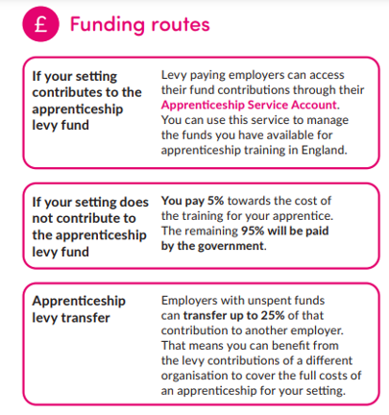
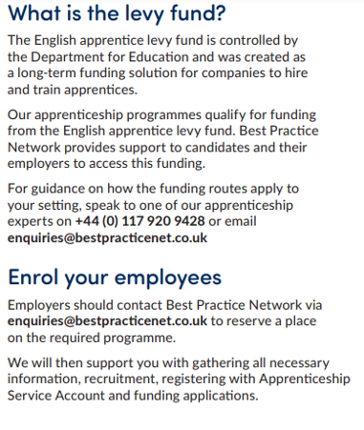
Funding
Early Years Practitioner L2 - £4000
Early Years Educator L3 - £7000
Early Years Lead Practitioner L5 - £8000
Maximum employer contribution: £400
If your setting has fewer than 50 employees: You will receive 100% of the funding where the apprentice is 16-21 years old or is between 22 and 24 years old and has an education, health and care plan.
Employers and training providers will both receive an additional £1000 where the apprentice is between 16 and 18 years old.
Notes:
Requirements for apprentices:
Must be doing 16 contracted hours per week with employer
Employer must agree to apprenticeship, to support, provide a mentor, give off the job training and to fund the apprenticeship.
Must not be asked to pay for the apprenticeship.

Slide 14
Next steps
Any questions?
How do I apply?
Applications can be made through our website:
https://www.bestpracticenet.co.uk/early-years

